Slide 1
Chapter 4
CONCEPTS OF LEARNING, CLASSIFICATION AND REGRESSION
Cios / Pedrycz / Swiniarski / Kurgan

Slide 2
Outline
Main Modes of Learning
Types of Classifiers
Approximation, Generalization and Memorization

Slide 3
Main Modes of Learning
Unsupervised learning
Supervised learning
Reinforcement learning
Learning with knowledge hints and semi-supervised learning

Slide 4
Unsupervised Learning
Unsupervised learning, e.g., clustering, is concerned with an automatic discovering of structure in data without any supervision.
Given N-dimensional dataset X = {x₁, x₂,…, x_{N}}, where each x_{k} is characterized by a set of attributes, determine structure, i.e., identify and describe groups (clusters) present within X.

Slide 5
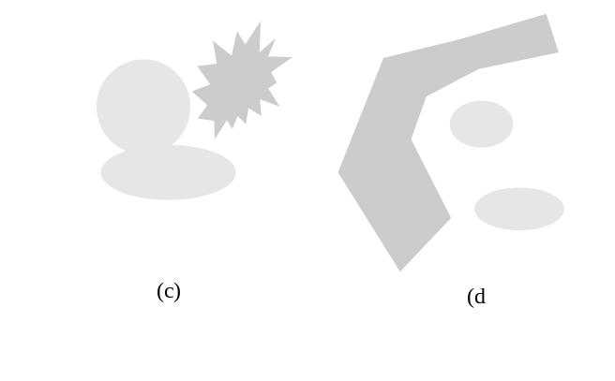
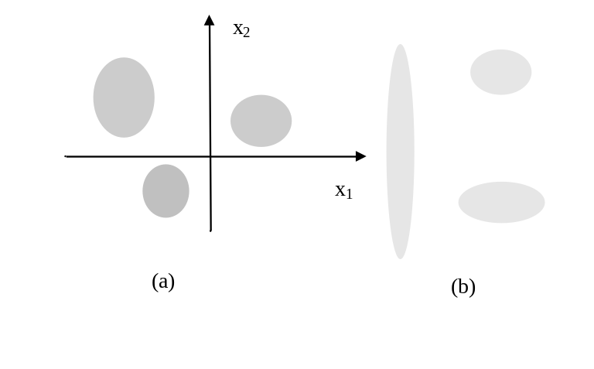
Examples of Clusters
Geometry of clusters (groups) and a way of bringing patterns together

Slide 6
Defining Distance/Closeness of Data
Distance function d(x, y) plays a pivotal role when
grouping data
Conditions for a distance metric:
d (x,x) = 0
d(x, y ) = d(y,x) symmetry
d(x, z) + d(z, y) d(x,y) triangle inequality

Slide 7
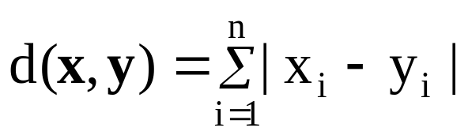
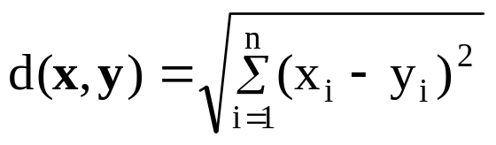

Examples of Distance Functions
Hamming distance
Euclidean distance
Tchebyschev distance

Slide 8
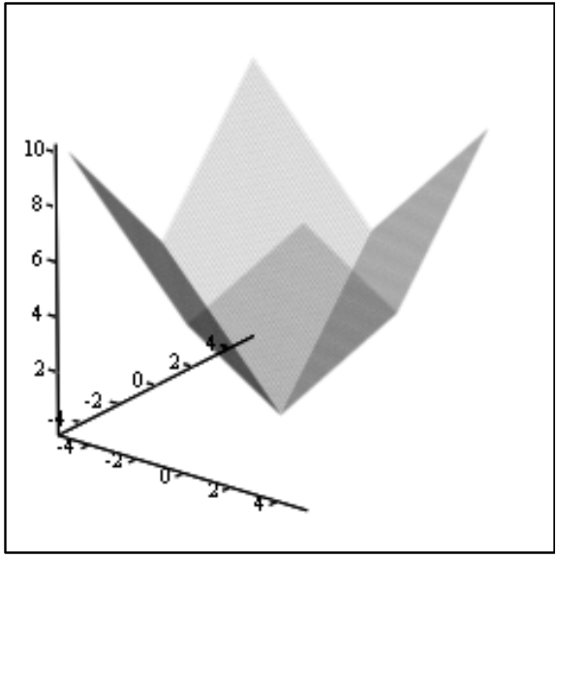
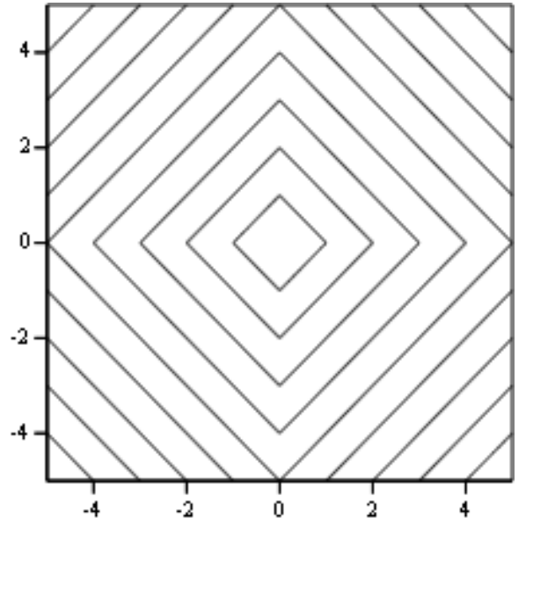
Hamming Distance

Slide 9
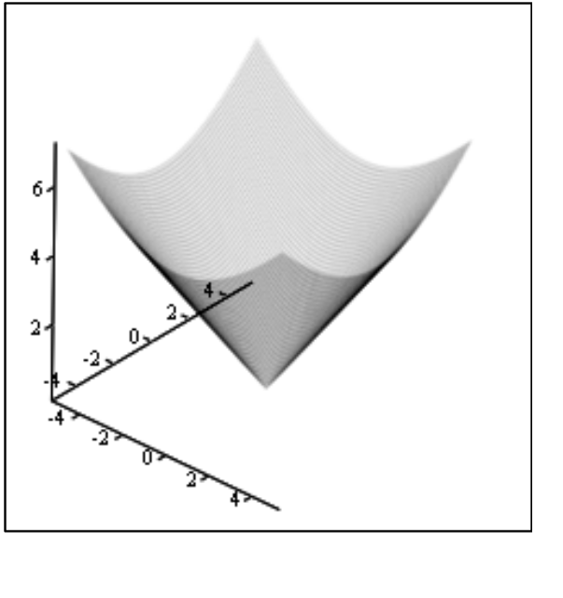
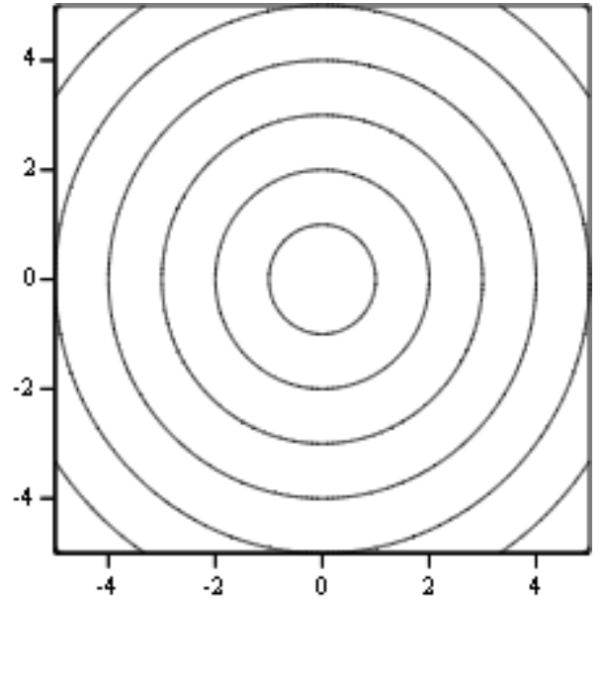
Euclidean Distance

Slide 10
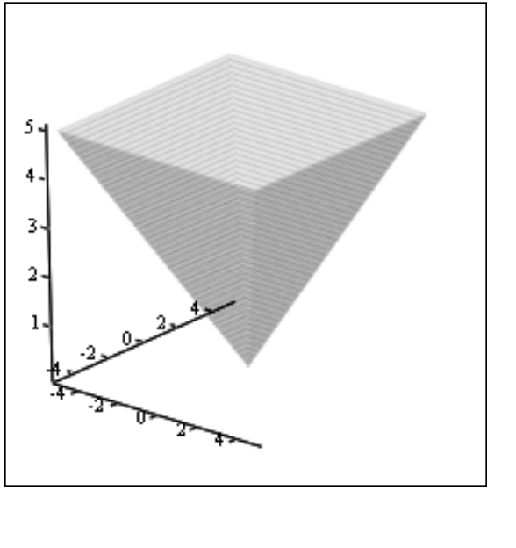
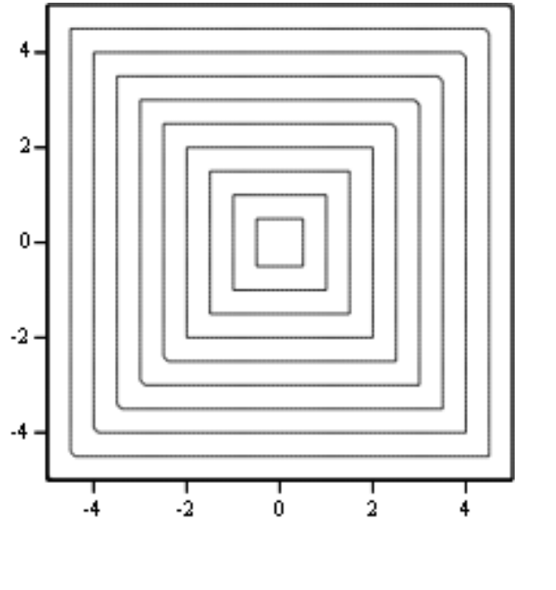
Tchebyschev Distance

Slide 11
Supervised Learning
We are given a collection of data (patterns) and their characterization:
in the form of some discrete labels (in which case we refer to a classification problem) or
some values of a continuous variable (which leads to a regression or approximation problem).

Slide 12
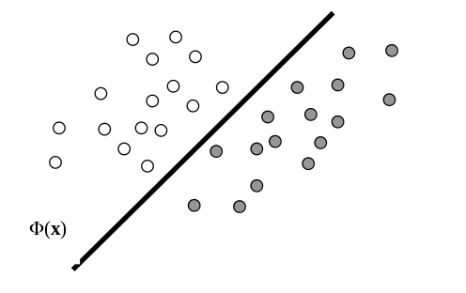
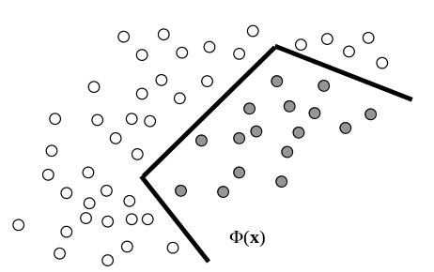
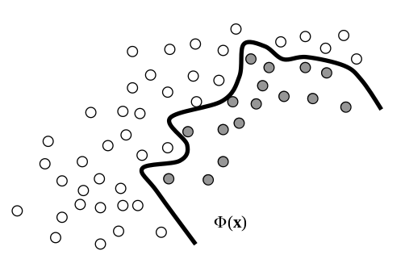
Examples of Classifiers
Linear classifier
Piece-wise linear classifier
Nonlinear classifier

Slide 13
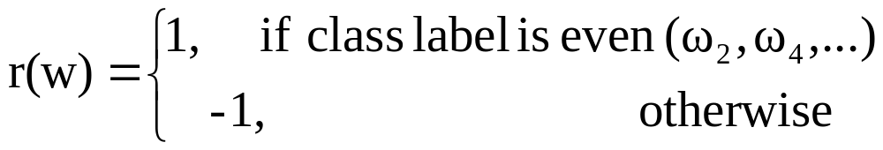
Reinforcement Learning
In reinforcement learning we are guided by less detailed information (supervision mechanism) than the one encountered in the case of supervised learning.
This comes in the form of some reinforcement information (reinforcement signal).
For instance, given “c” classes, the reinforcement signal r(w) could be binary in its nature:

Slide 14
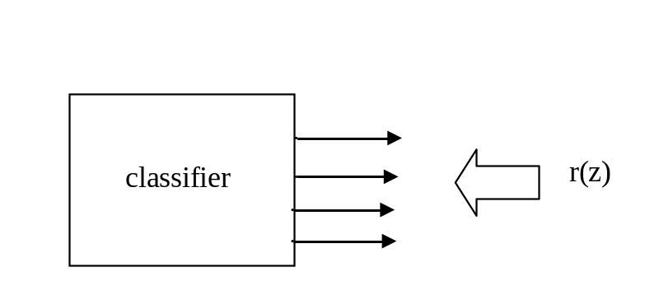
Reinforcement Learning:
Examples of Reinforcement Signals
Reinforcement in classification- partial guidance through class combination

Slide 15
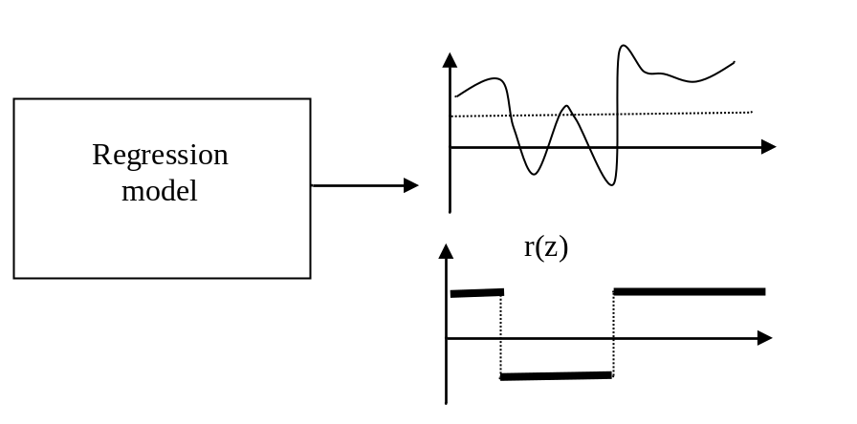
Reinforcement Learning:
Examples of Reinforcement Signals
Reinforcement in regression- thresholded version of target signal

Slide 16
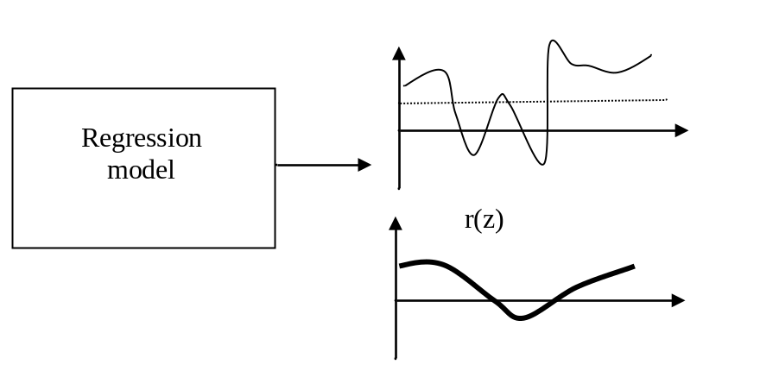
Reinforcement Learning:
Examples of Reinforcement Signals
Reinforcement in regression- partial guidance through aggregate of signal (average)

Slide 17
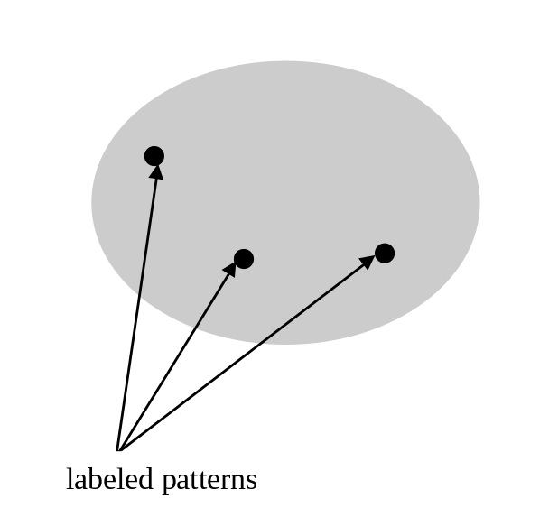
Learning with Knowledge Hints and
Semi-supervised Learning
Typically, we encounter some domain knowledge when dealing with clustering.
It may come in the form a small portion of labeled data and is essential in navigating the clustering algorithm.

Slide 18
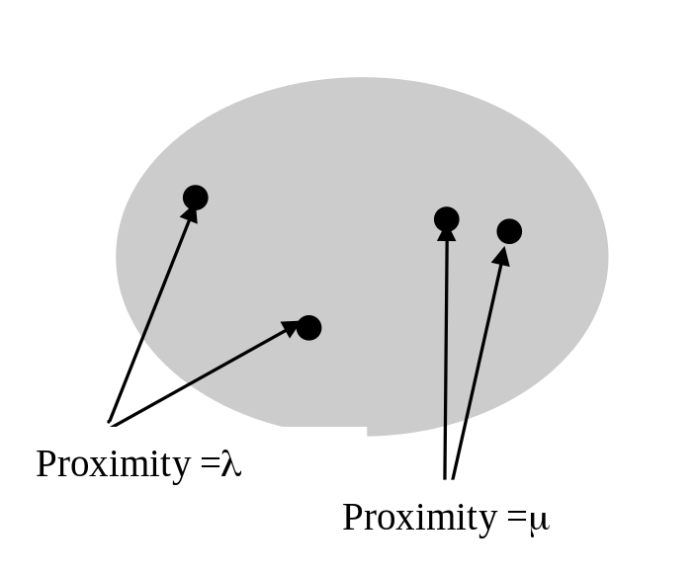
Learning with Proximity Hints
Instead of class labels, we may have pairs of data
for which proximity levels have been provided.
Advantages:
Number of classes is not required
Only some selected pairs of data are
considered

Slide 19
Classification Problem
Classifiers are constructs (algorithms) that discriminate between classes of patterns.
Depending upon the number of classes in the problem, we encounter two- and many-class classifiers.
The design of the classifier depends upon the character of data, number of classes, learning algorithm and validation procedures.
Classifier can be regarded as the mapping (F) from feature space to class space
F: X → {ω₁, ω₂, …, ω_{c}}

Slide 20
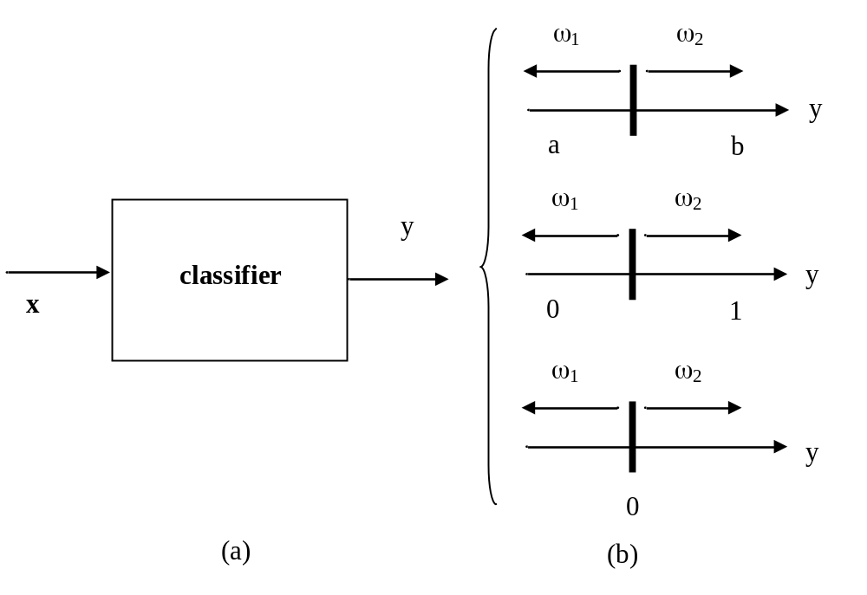
Two-Class Classifier and
Output Coding

Slide 21
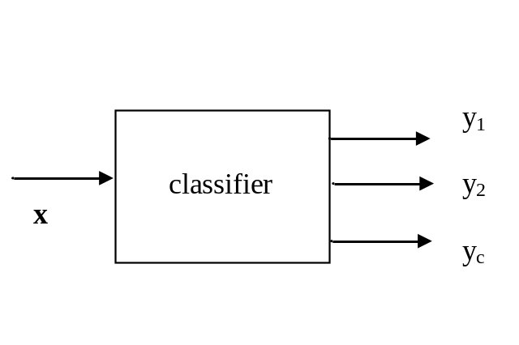
Multi Class Single Level Classifier
Maximum of class membership- select class (i0) for which
i0 = arg max {y1, y2,…, yc}

Slide 22
Multi Class Dichotomic Classifier
The other general approach is to split the c-class problem into a
subset of two-class problems.
In each, we consider class, say ω₁, and the other class are formed
by all the patterns that do not belong to ω₁.
Dichotomic decision:
Φ₁(x) 0 if x belongs to ω₁
Φ₁(x) < 0 if x does not belong to ω₁

Slide 23
Multi Class Dichotomic Classifier
Dichotomic decision:
Φ₁(x) 0 if x belongs to ω₁
Φ₁(x) < 0 if x does not belong to ω₁
Cases:
only one classifier generates a nonnegative value
several classifiers identify the pattern as belonging to a specific class.
Conflict class assignment
no classifier issued a classification decision –
undefined class assignment.

Slide 24
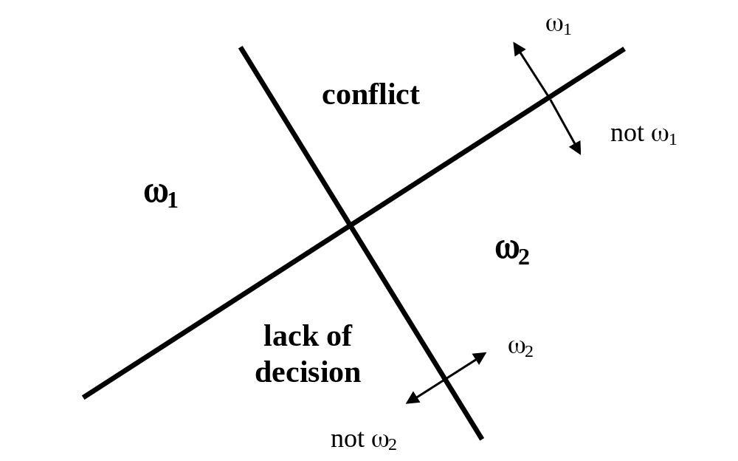
Multi Class Dichotomic Classifier

Slide 25
Classification and Regression
When contrasted with classification, in regression, we encounter
a continuous output variable
an objective is to build a model (regressor) so that a
certain approximation error is minimized
Consider a data set formed by pairs of input-output data
(x_{k}, y_{k}), k = 1, 2,…,N where y_{k} is in R
The regression model (regressor) comes in the form of some mapping F(x) such that for any x_{k} we obtain F(x_{k}) as close to y_{k} as possible

Slide 26
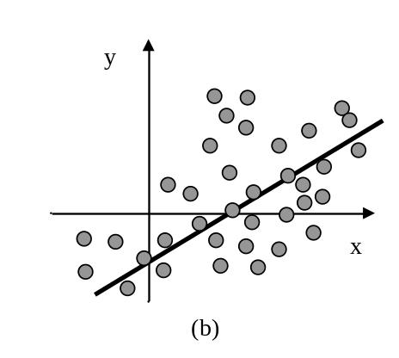
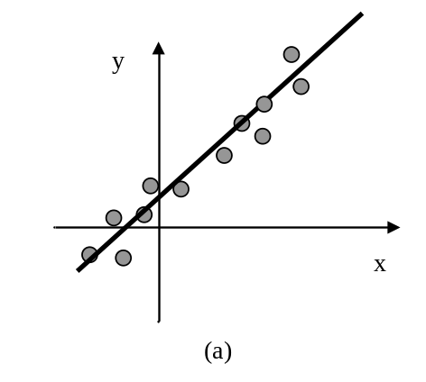
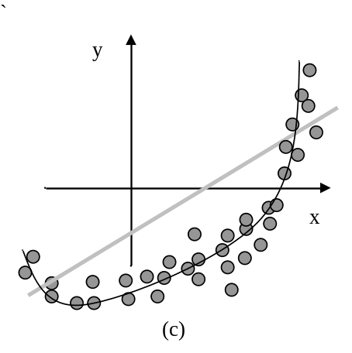
Examples of Regression Models
Linearly distributed data
High dispersion
Linearly distributed data
Low dispersion
Nonlinearly distributed data
Low dispersion

Slide 27
Main Categories of Classifiers
Explicit and implicit characterization of classifiers:
Explicitly articulated function (linear, polynomial, neural network, etc.)
Implicit – no formula but rather a description, say decision tree,
nearest neighbor classifier, etc.

Slide 28
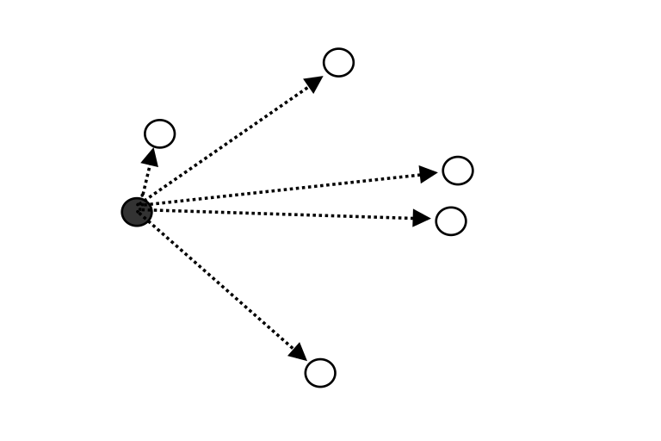
Nearest - Neighbor Classifier
Classify x considering class of the nearest neighbor
L = arg min_{k} ||x – x_{k}|| class of x is the same as the class to which x_{L} belongs to

Slide 29
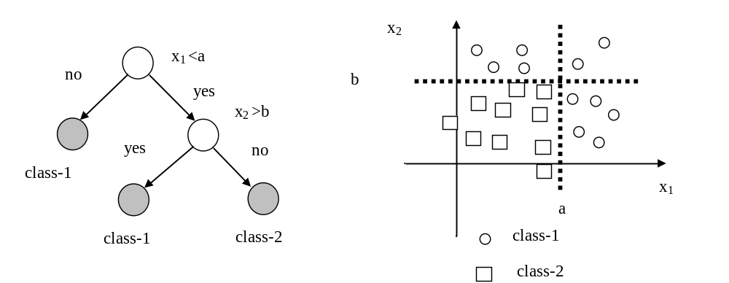
Decision Trees
Boundaries formed by guillotine cuts

Slide 30
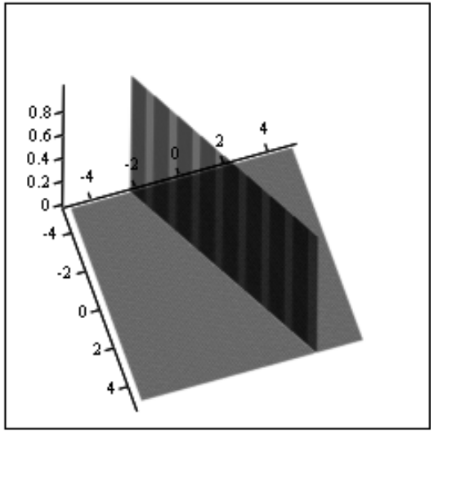
Linear Classifiers
Linear function of of the features (variables)
Φ (x) = w₀ + w₁x₁ + w₂ x₂ + … +w_{n} x_{n}
Parameters of the classifier: w₀, w₁, ….
Geometry: line, plane, hyperplane
Linear separability of data

Slide 31
Linear Classifiers: Notation
Linear classifiers produce good results when data (classes) are linearly separable. They can be conveniently described in a compact form by introducing the following vector notation:
Φ(x) = w^{T} x~
where w = [w₀ w₁ …w_{n}]^{T} and x~=[1 x₁ x₂ … x_{n}] .
Note that x~ is defined in an extended input space that is
x~ =[1 x]^{T}

Slide 32
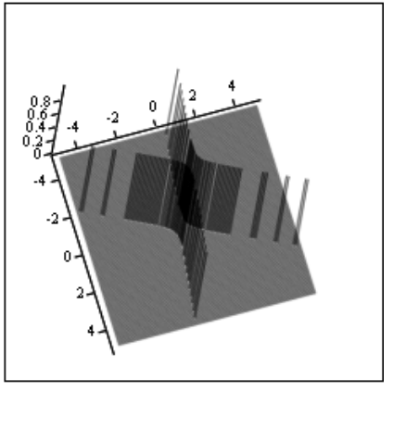
Nonlinear Classifiers
Polynomial classifiers:
Φ(x) = w₀ + w₁x₁ + w₂ x₂ + … +w_{n} x_{n} +
+ w_{n+1}x₁² + w_{n+2}x₂²+ … + w_{2n} x_{n}²+
+ w_{2n+1}x₁x₂ +....
Enhanced functionality and nonlinear boundaries at expense of increased dimensionality of feature space

Slide 33
Learning Algorithms
Linear classifier – zero error leads to the system of inequalities:

Slide 34
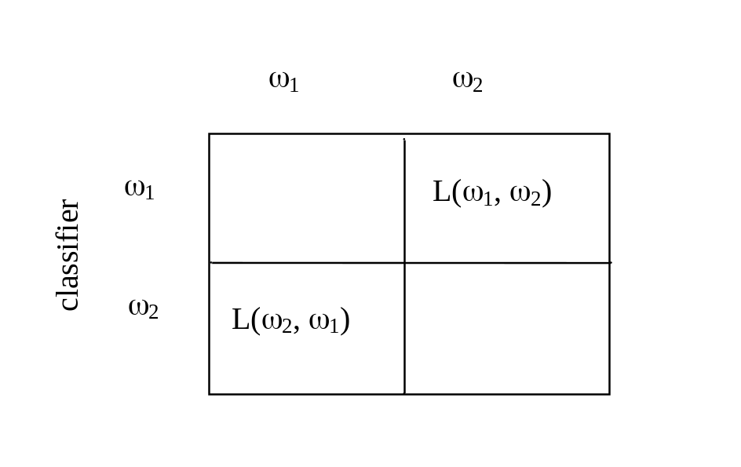
Performance Assessment
Loss function: L(ω₁, ω₂) and L(ω₂, ω₁)
Correct classification
losses

Slide 35
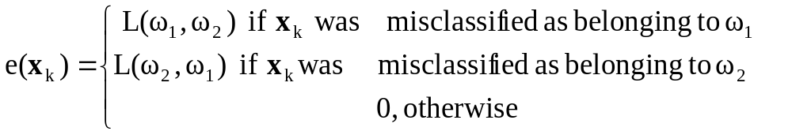
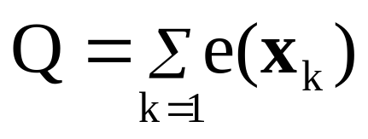
Performance Assessment
The overall performance index we use to measure the quality of the classifier can be expressed in the form:
-for the k-th data
Overall we sum up the above expressions over all data to express a cumulative error

Slide 36
Generalization Aspects of Classifiers and Regression Models
Performance of the classifier is assessed with regard to unseen data.
Typically, the available data are split into tow or three disjoint subsets
Training
Validation
Testing
Training set - used to complete training (learning) of the classifier.
All optimization activities are guided by the performance index
and its changes are reported for the training data.

Slide 37
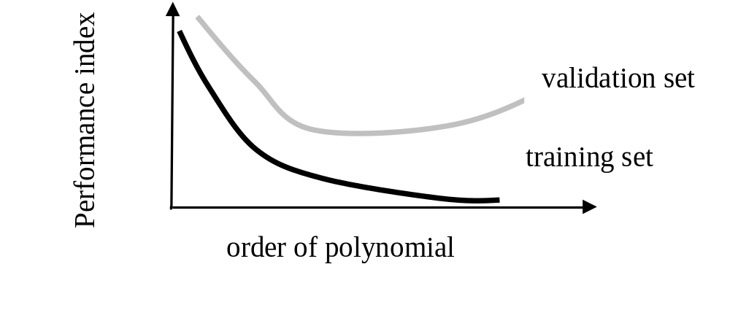
Training and Validation Sets
Consider polynomial classifiers
Monitoring structural complexity
Validation set is essential in selecting a structure of classifiers
By using validation set, we can determine an optimal order
of the polynomial

Slide 38
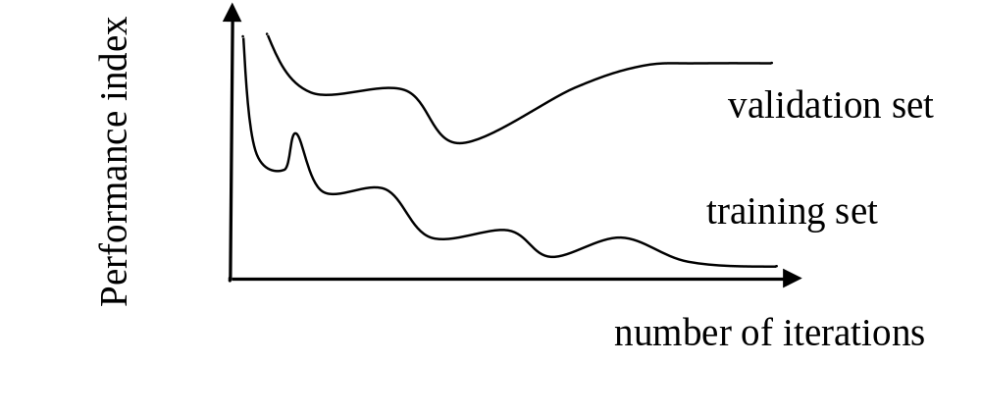
Overtraining
Avoidance of overtraining

Slide 39
Approximation, Generalization and
Memorization
Approximation – generalization dilemma: excellent performance of
training set and unacceptable performance on testing set.
Attributed to a lack of generalization capabilities
Memorization effect– data becomes memorized (including those that
are noisy) and classifier exhibits poor generalization abilities

Slide 40
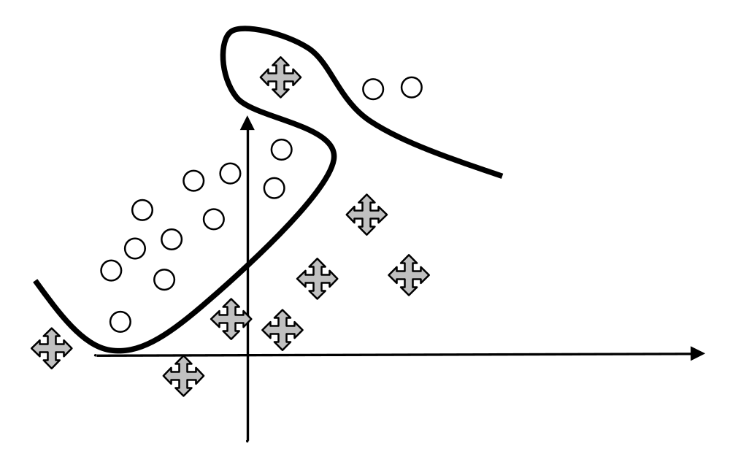
Approximation, Generalization and
Memorization
Nonlinear classifier produced zero classification error;
Poor generalization abilities

Slide 41
References
Bishop, C.M. 1995. Neural Networks for Pattern Recognition, Oxford University Press
Duda, R.O, Hart, PE and Stork DG. 2001 Pattern Classification, 2nd edition, J. Wiley
Kaufmann, L. and Rousseeuw, P.J. 1990. Finding Groups in Data: An Introduction to Cluster Analysis, Wiley
Soderstrom, T. and Stoica, P. 1986. System Identification, Wiley
Webb, A. 2002. Statistical Pattern Recognition, 2nd edition, Wiley

